Slide 1
Analysis of Wages Level by Occupation in SF
Team members: Xu Deng Meng Hao Hsu

Slide 2
Agenda
Goals
Use case
Methodology
Data sources
Milestones
Programming in scala
Acceptance criteria

Slide 3
Our Goals
Divide different wages level by occupation.
User can search by keywords or wage range.
User should get intuitive and helpful information by searching through our User Interface.

Slide 4
Use case
For employer to gain business insight.
For employee to take references in salary negotiation.
For students and job-seeker to take into consideration in decision making.

Slide 5
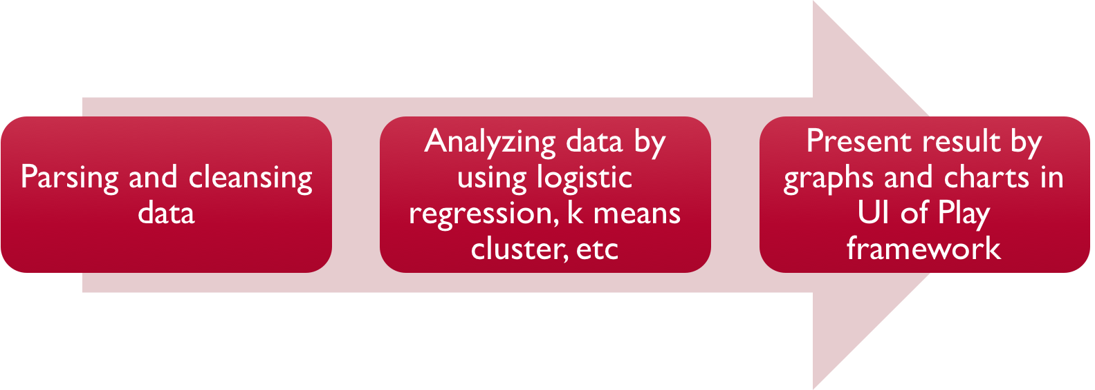
Methodology
Notes:
linear regression, logistic regression, k means cluster

Slide 6
Data Source
Data source: One of the dataset from https://www.kaggle.com/kaggle/sf-salaries.
Show wages from 2011 to 2014 in San Francisco.
More than 150K employees in the dataset.
Notes:
Different city

Slide 7
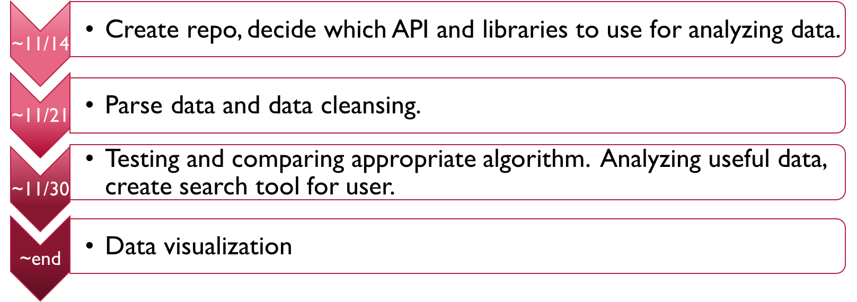
Milestone

Slide 8
Programming in scala
Data Parsing. (JSON format)
Model Building and Processing.
Using Spark to manipulate data.
Request Handling and Visualization.
Test Driven.

Slide 9
Acceptance criteria
Acceptable lower bound of accuracy should close to 0.7.
User should get their result in 5 seconds.

Slide 10
Thank you!

